Slide 1
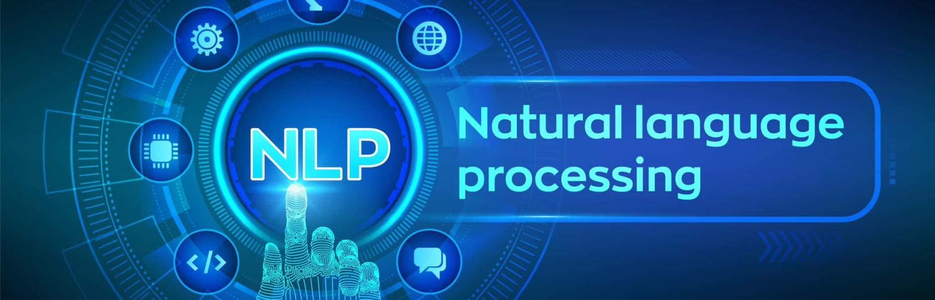
Data 606 Capstone Project: NPR Speaker Identification with Text Data
Reed Balentine, Khiran Kumar, Daniel Thang
Notes:
Hello

Slide 2
Purpose
Purpose: Build a machine learning model that can reliably predict who the speaker is for lines of dialogue from NPR Radio Transcripts.
Due to the messy nature of text, analyzing and organizing is time-consuming, so most companies fail to use it to its full potential.
Vital practice for automating business processes, and making data-driven business decisions.
Motivation for using ML: Scalability, Real-time Analysis, Consistent Criteria
Notes:
Daniel
The purpose of our project is to Build a machine learning model that can reliably predict who the speaker is for lines of dialogue from NPR Radio Transcripts. Being able to automate the process of identification through the patterns of text data is a difficult task but it is a great way to analyze text data to its full potential since the methods used can be applied to other text data that is probably more structured than media transcripts, so their accuracy will be much higher.
“It’s estimated that around 80% of all information is unstructured, with text being one of the most common types of unstructured data. Because of the messy nature of text, analyzing, understanding, organizing, and sorting through text data is hard and time-consuming, so most companies fail to use it to its full potential.” So, using text classifiers and NLP techniques, companies can automatically structure all manner of relevant text, from emails to social media to, in our case, NPR media transcripts, in a fast and cost-effective way. This allows companies to save time analyzing text data, automate business processes, and make data-driven business decisions. (Monkey Learn).
So some of the benefit of using machine learning techniques for text classification includes Scalability, since manually analyzing and organizing is slow and much less accurate so ML can automate that, and real time-analysis, which is great for allowing you to take immediate actions during critical situations, and lastly, having Consistent criteria allows you to eliminated human errors and subjectivities. And so, NLP methods will also be vital to our project since it helps resolve ambiguity in language and adds useful structure to the data for many downstream applications, like text classification. (Monkey Learn)

Slide 3
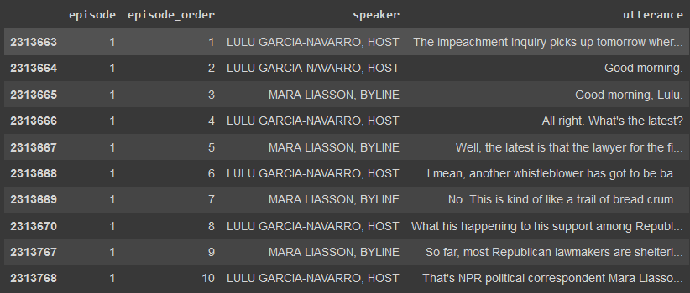
NPR Dataset
Natural Language Processing speaker identification
Dataset: NPR Media Dialog Transcripts
~105,000 Episodes from 1999-2019
~3.2 million spoken lines
Kaggle Link: https://www.kaggle.com/datasets/shuyangli94/interview-npr-media-dialog-transcripts
Focused on identifying which person speaking is the host, or the identity of the host.
How will the data like host-map.json be processed and used when matching the episode id to the host’s name? Will the headline.cvs or other data in the folder be used? If so, what’s their relations with the main data. Will we combine the other dataset to the main one, like concatenate or something?
I think we will use the utterences csvs, I don’t think headline or episode will be needed as they are extra data. host-map will be useful for attaching id’s to each utterence of the host to use as a target variable. There is also a json that has the data pre-split into test-train-validation that may or may not be useful
7 separate files, 4 csv, 3 json.
host-map is a list of episodes each host is in
*Add sample picture of dataset*
Notes:
REED
Your words
“Goal is to build a machine learning model that can reliably predict who the speaker is for a given line or lines of dialogue. Probably focusing on identifying which person speaking is the host, or the identity of the host.”

Slide 5
Findings on dataset?
Anything you found when playing with the dataset that can help audience better understand the data
Any transformations or cleaning needed?
Have not gotten fully into it, but only 562 rows w/ missing data
Any basic finding when doing some exploratiory data analysis on the data?
Maybe like which methods mentioned in the next slides cannot be used at all or which methods should absolutely be used?

Slide 6
Overview of Methods
Sentence Embedding or constructing NER pipelines: SpaCY, NLTK
Feature Extraction: TF-IDF vs. Word2vec
Classification Models: Naive Bayes, SVM, KNN, Random Forest
Models/Approaches: RNN, BERT, applying multiple NLP techniques in tandem and weighting their classifications together
Notes:
Khiran
We are researching a few different methods for our projects to see which one applies best to our dataset. Sentence embedding tools are vital for an NLP project and it is used to map sentences and their semantic information's to vectors of real numbers. Constructing Named Entity recognition pipelines is another important tool, where key information or entities within a text are detected and classified. And so for the pipelines, there is a few good open-source software library for NLP, such as SpaCY, which has trained English pipelines optimized for CPU, or NLTK, which includes a set of text processing libraries for tokenization and semantic reasoning.
For feature extraction, using the traditional bag-of-words model, TF-IDF vectors, to quantify important strings is a popular choice or using the relatively new classifier, word2vec model, for a deeper understanding of the subsets of the content we want is another popular method.
We also might want to apply different classification models such as Naive Bayes, SVM, KNN, or Random Forest, which are popular text classification methods, and compare the accuracy rates.
We also want to try out different models and approaches, RNN being the main one, as well as exploring other pre-trained models like GOOGLE’s BERT, which a transformer language model that was only recently created in 2018. We also might try applying multiple NLP techniques in tandem and weighting their classifications together for favorable accuracy scores. Time will only be the deciding factor in how much we can explore to get the desirable results we want.

Slide 7

Thank you, Any Questions?

